Slide 1
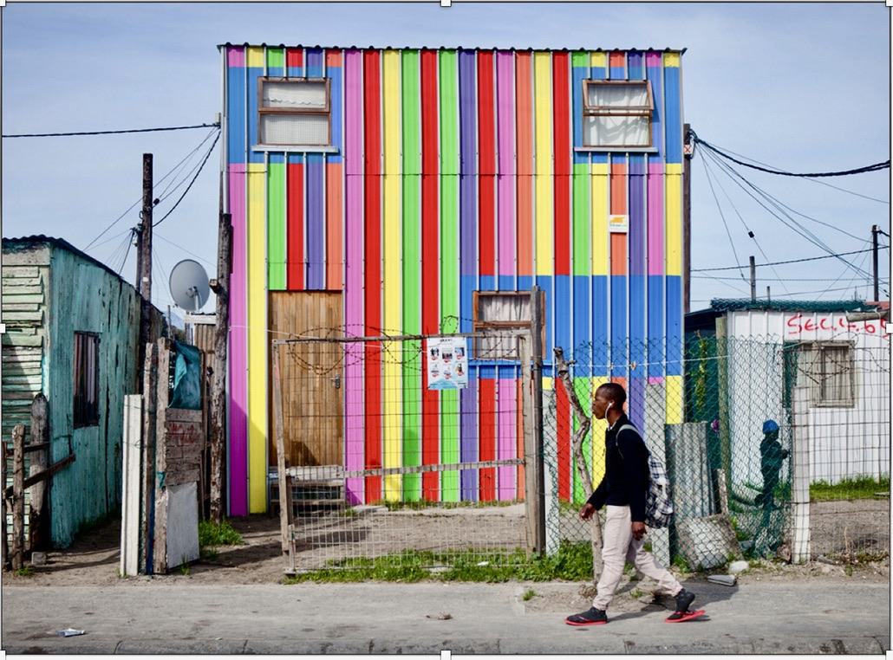
Ikhayalami Development services
Company
profile

Slide 2
Table of Contents
Introduction
What Makes Us Unique
Our Approach
Our Services
Our Technologies
Key Benefits
Meet Our Directors
Contact Details

Slide 3
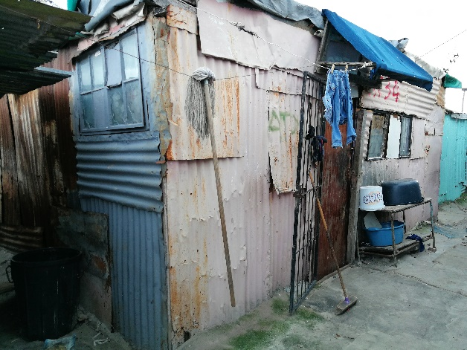
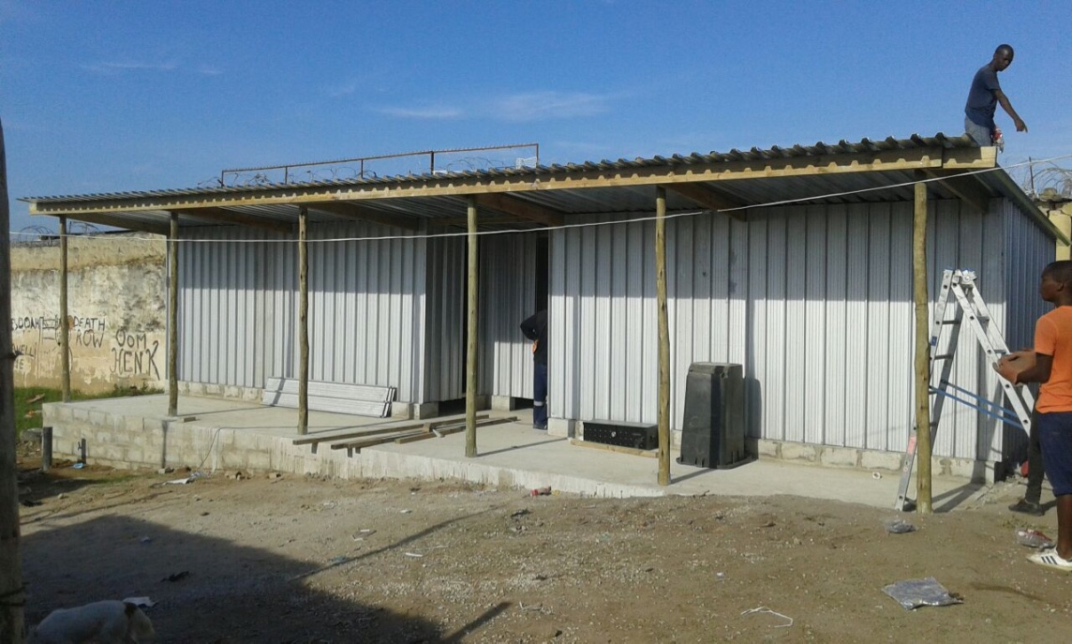
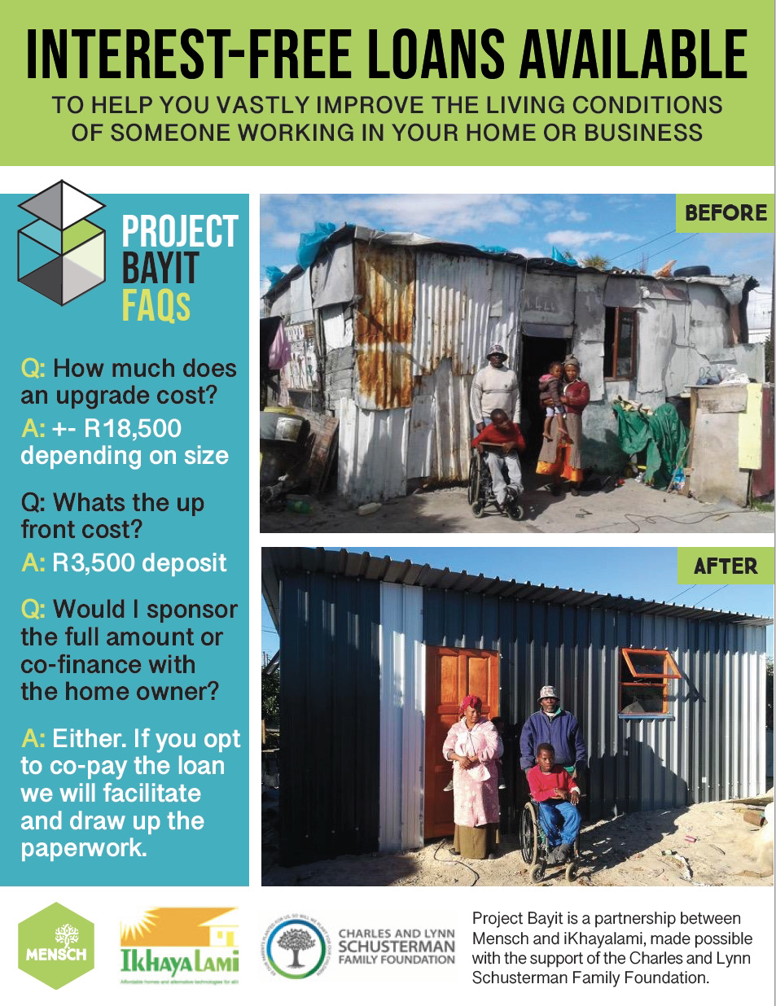
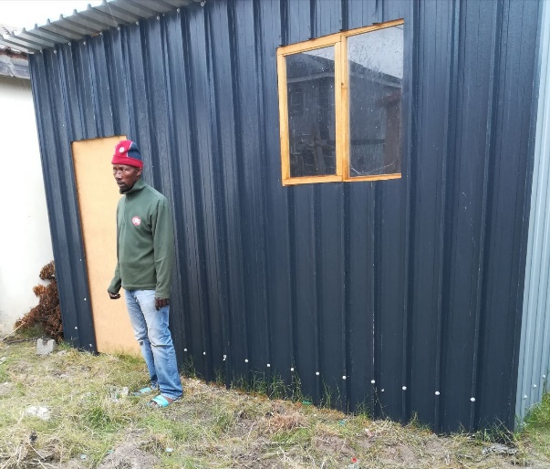
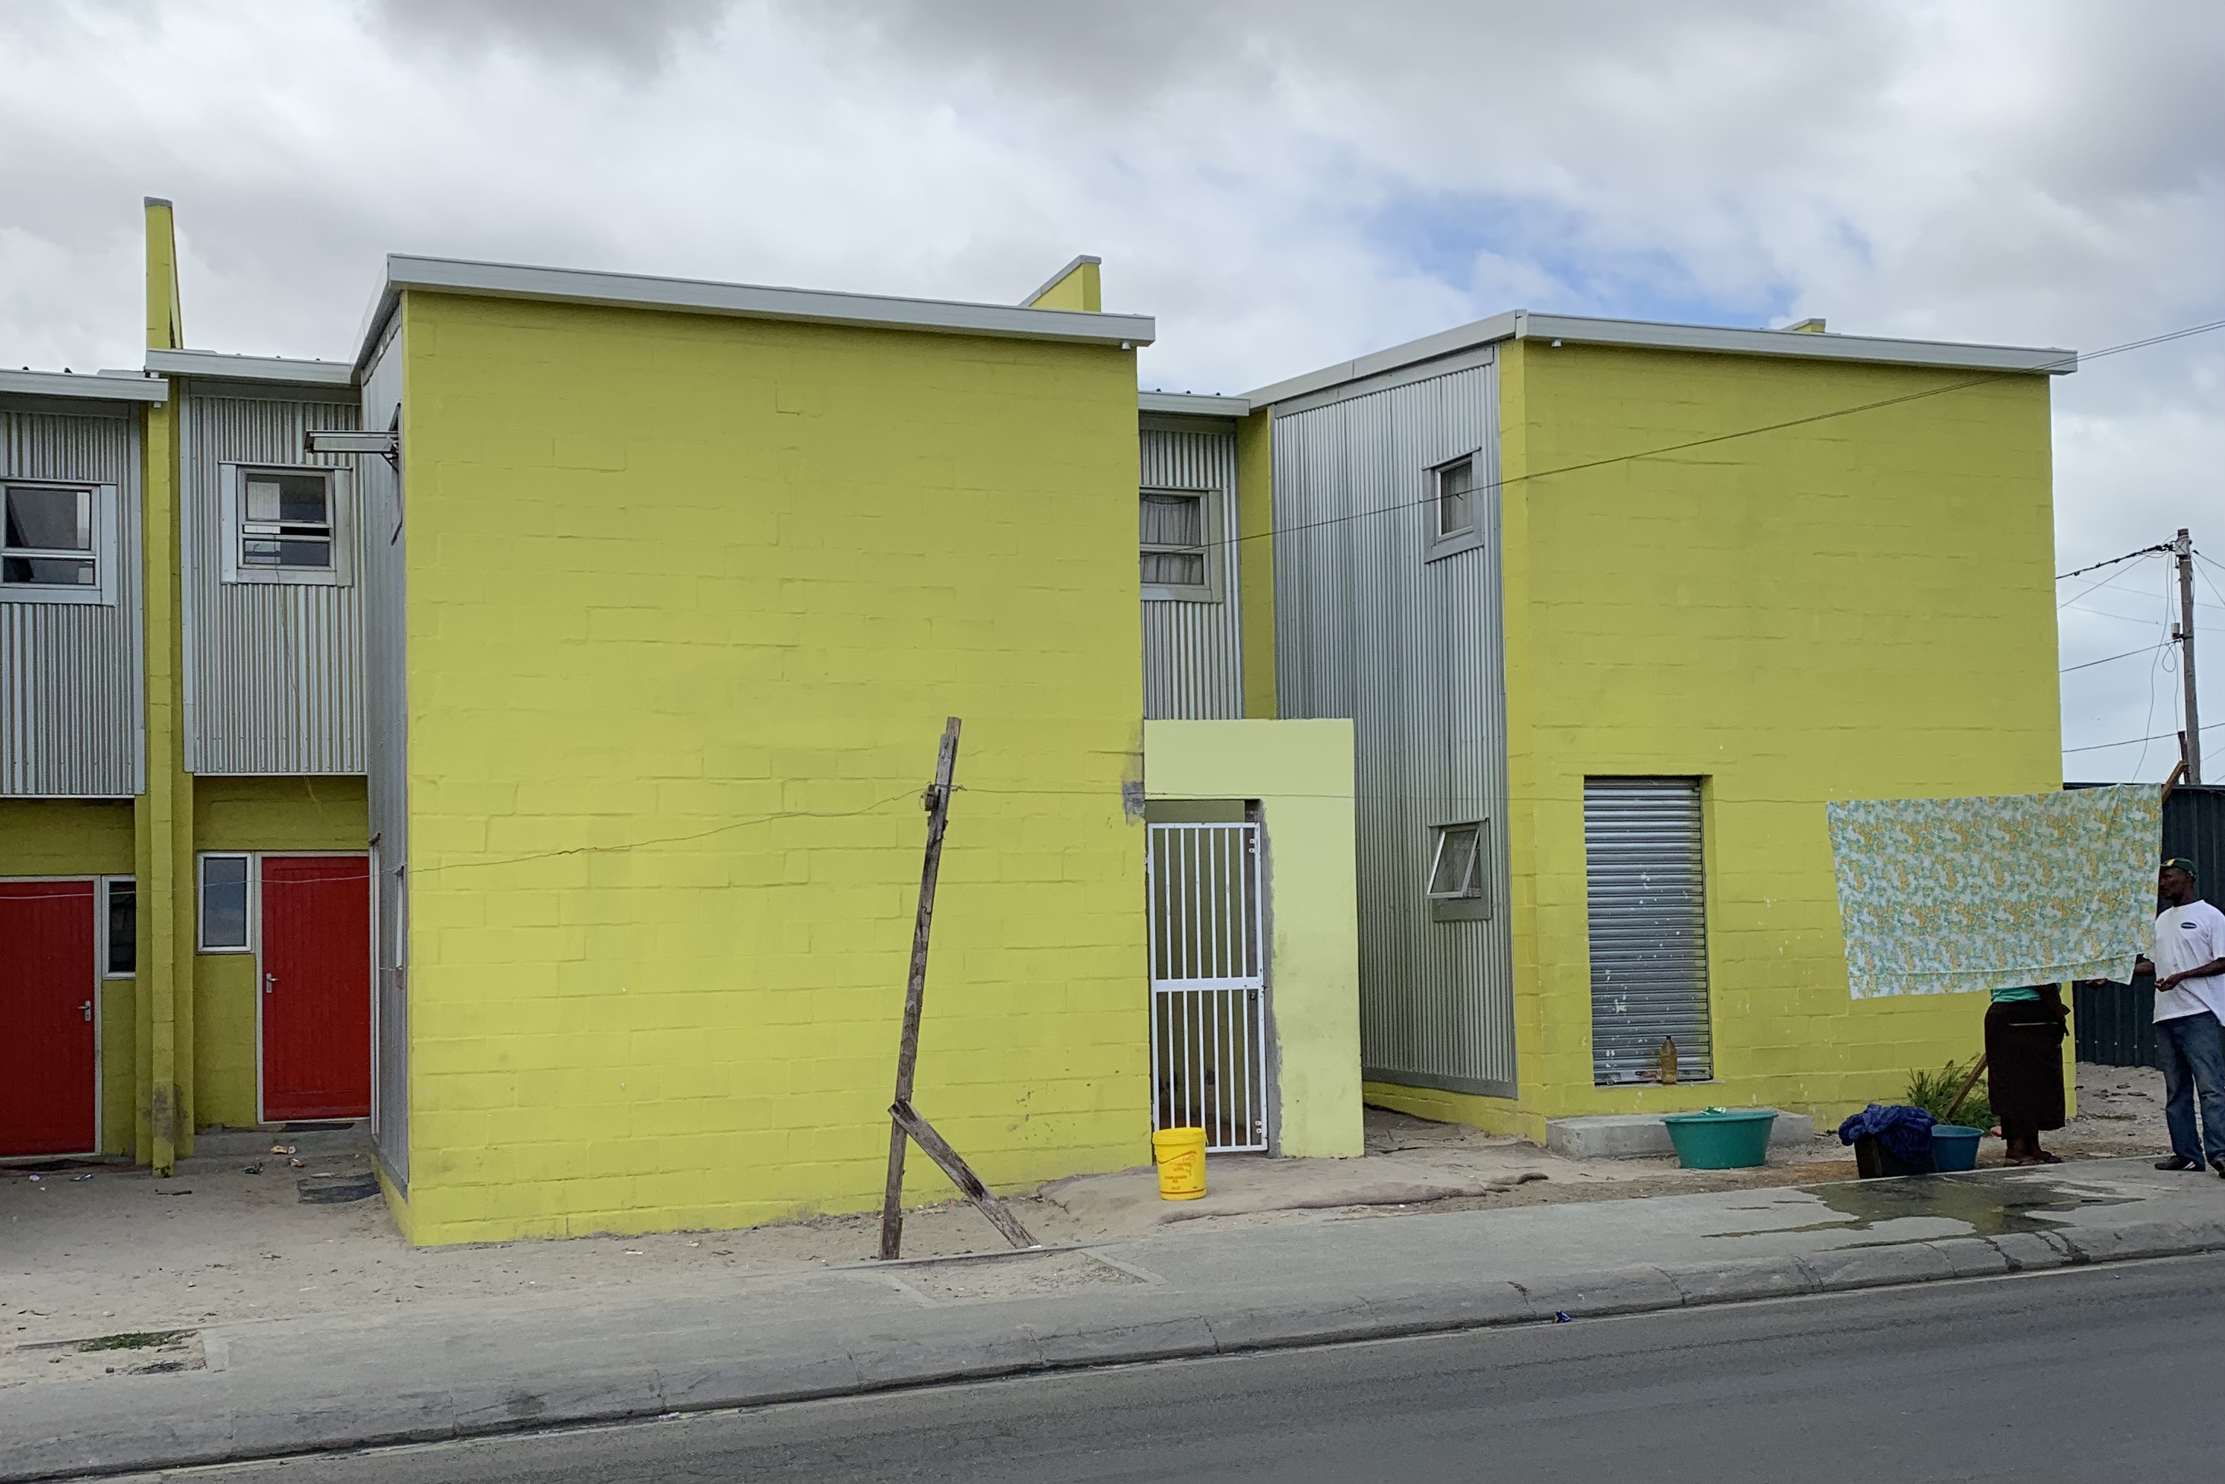
Key Projects
Disaster Relief
Shack Upgrading
EmpowerShack
Creches & Community Halls
Innovative Shelter Finance
Re-blocking

Slide 4
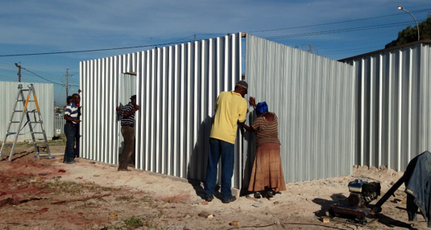
INTRODUCTION
iKhayalami is a level 1 BBBEE not-for-profit company with more than fifteen years on-the-ground experience.
We believe in partnering urban poor households to upgrade informal settlements and to improve lives by improving living conditions.

Slide 5
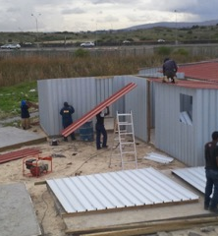
What makes us unique?
STRATEGIES: Our offices and our factory are located in the neighbourhoods in which we work. 90% of our staff, including management, come from these settlements. We co-create housing solutions - we don’t simply deliver them. We start with interventions for the poorest and then scale them upwards – so that we do not leave anyone behind.
SYSTEMS: Our operations are integrated across the entire housing supply chain, from design to manufacturing to distribution to construction. We draw in public and private role players, having developed innovative ways in which to bridge the finance gap, creating and preserving sustainability and household and neighbourhood assets.
SERVICE: We have in-house micro-finance management, technical support, and social facilitation. We have building teams that are experienced in shack upgrading and we have partnerships with architects and developers for more formal projects.

Slide 6
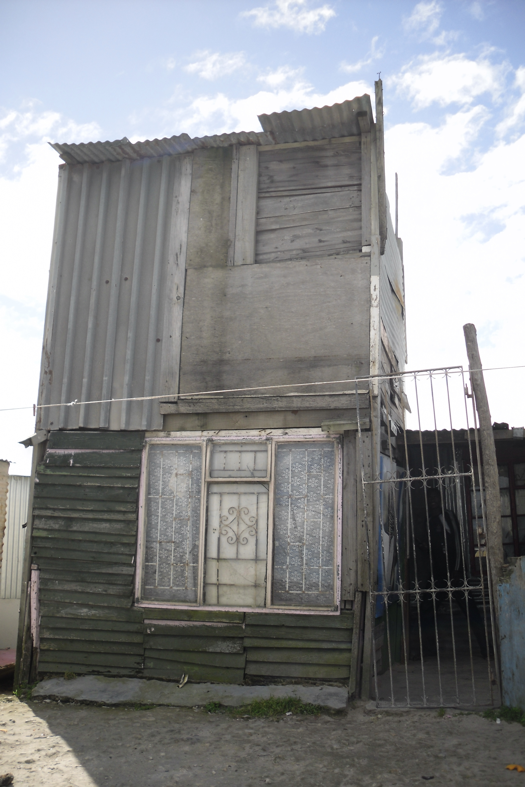
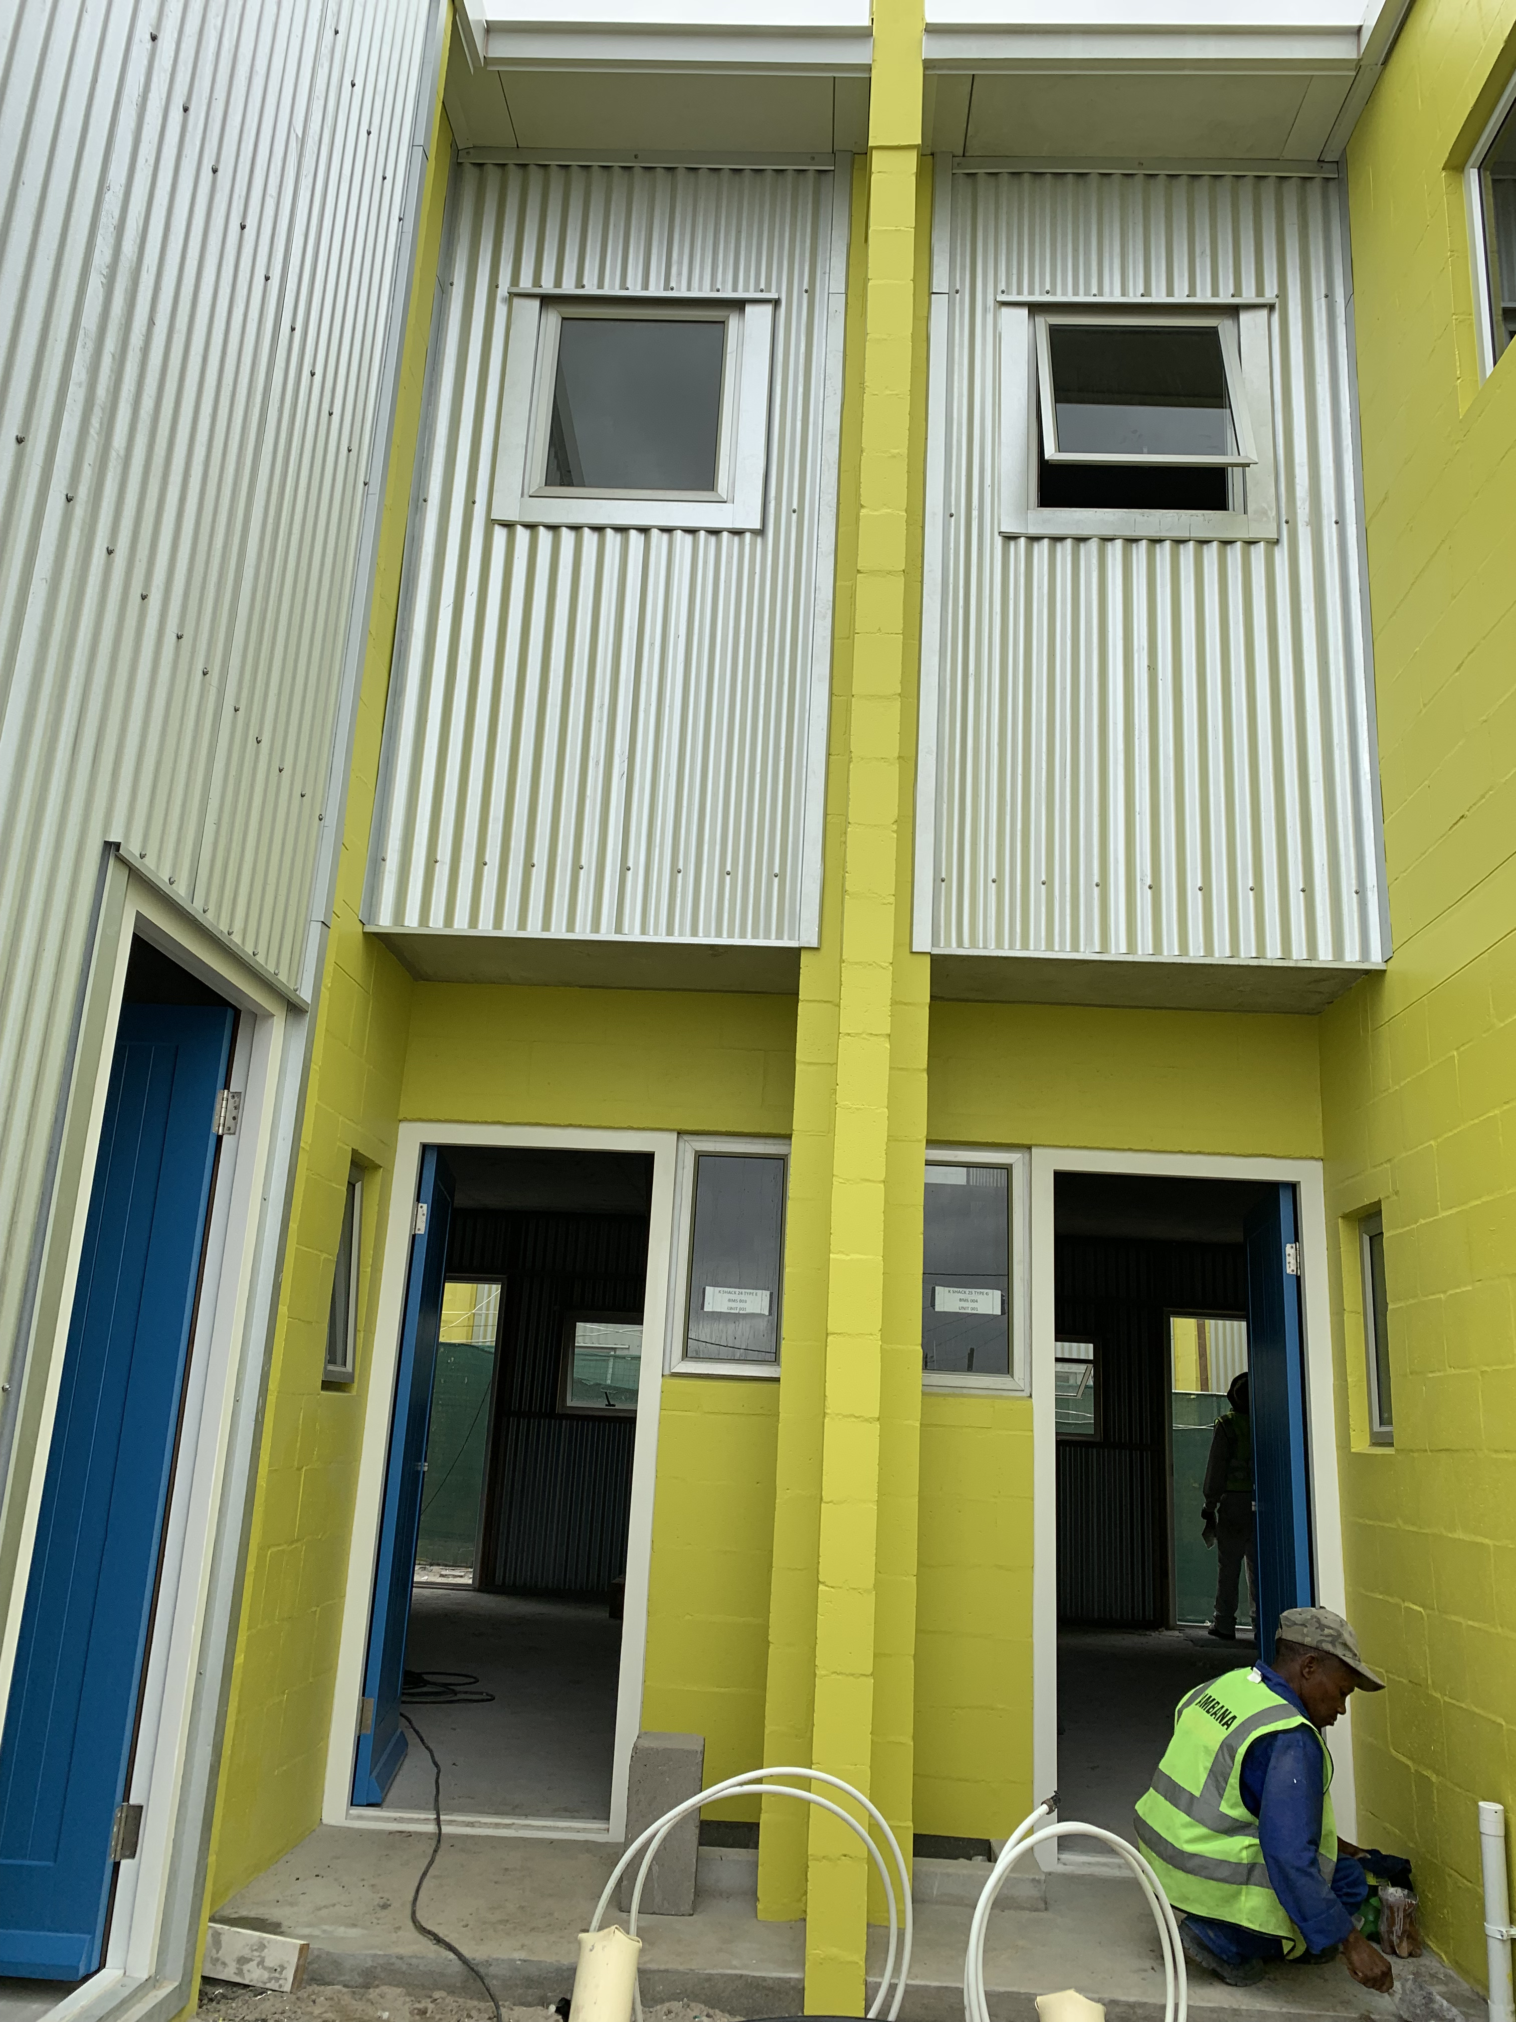
Our Approach
Our work is premised on the realization that
informality is an integral part of our cities and will
remain a permanent feature of our urban land-
scapes.
The informal built environment is not a problem as much as it is a response to problems caused by state and market failure.
Ikhayalami recognizes that by collaborating with urban poor communities and households we are better able to deliver our technical support, our systems of materials manufacture and supply and our innovative financing strategies. As a result we have been able to play a precedent-setting role in enabling assets in poor communities to evolve and in the process transforming our cities for the better.

Slide 7
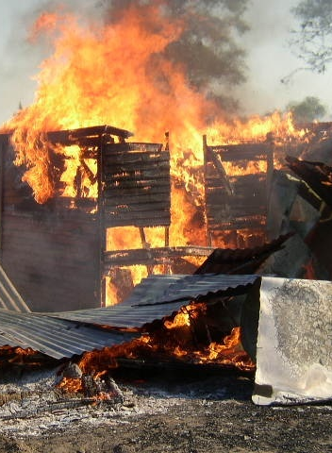
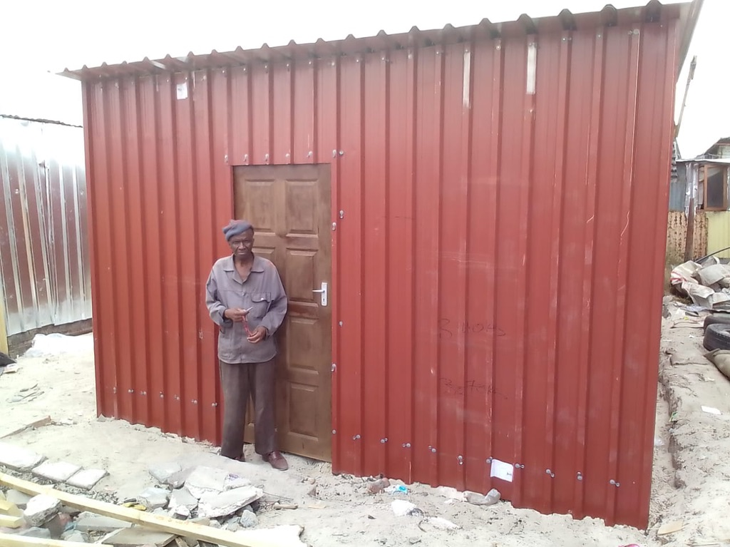
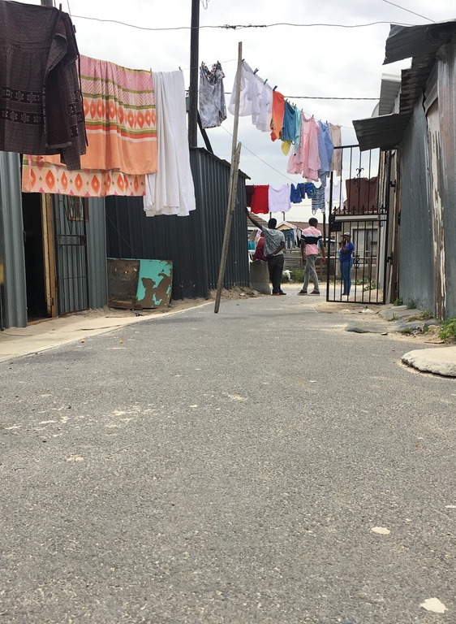
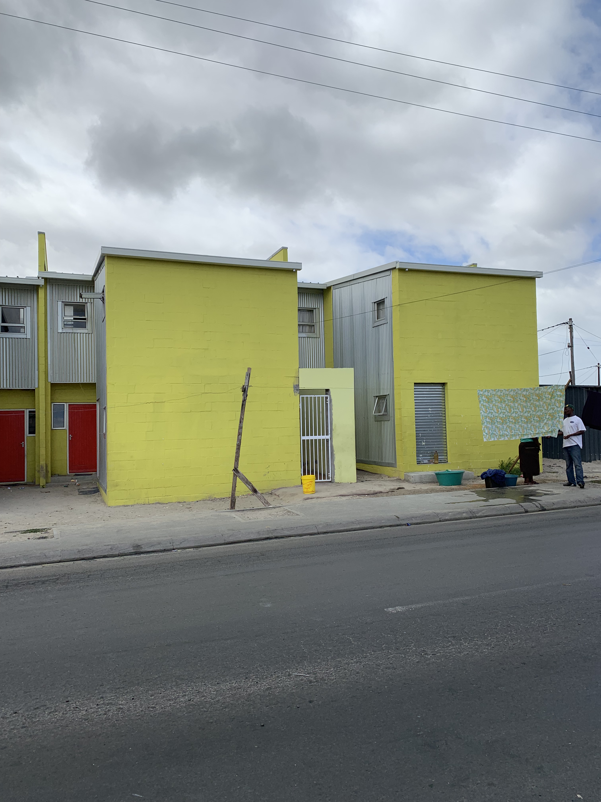
Our Services
We use grant finance from donors or the State to respond to disasters such as fires. We provide emergency solutions that can be easily upgraded into durable homes
We use our same modular technologies that are fireproof, easy to transport and quick to build, to assist individual households, who cannot secure formal housing, to upgrade, improve or extend their shacks.
We assist entire communities to re-configure their settlements in order to create space for roads and services, to produce public open space and to create the conditions for the regularization of these settlements.
We work with organized communities to design and develop innovative, incremental solutions in terms of layout and house design, traversing the divide between the informal and the formal.

Slide 8
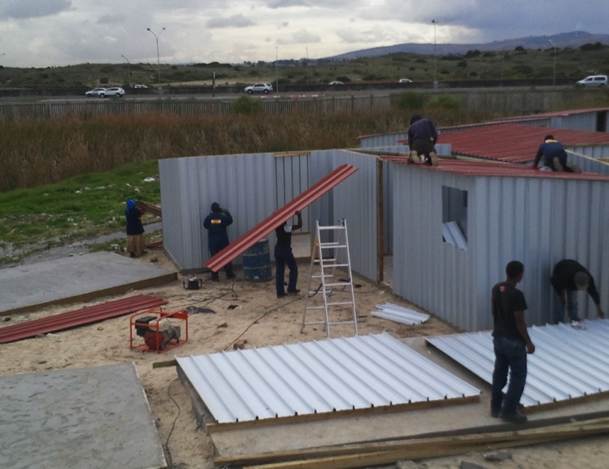
Our technologies
SOCIAL CAPITAL
We invest time and resources in building relationships with heads of households and with bona fide community structures and networks. We do not try to create social capital. We focus our efforts on durable neighbourhood level networks that have some degree of institutional form (community organizations, church groups women’s groups). We try to make our interventions so that they enhance the possibilities of translating this social capital into household and community wealth creation.
BUILDING TECHNOLOGY
For walling and roofing we use strong high-quality zinc sheeting that clips together easily. We use as little wood as possible. All units are modular and can be extended or repositioned with little difficulty. When necessary and affordable we build a shallow concrete plinth. We also provide standardized drainage solutions on request as well as starter solar units, ecological toilets and rainwater harvesting systems.
FINANCE CAPITAL
Our shelter micro-finance is more than the conventional approach. For a start we seek to leverage grant finance for vulnerable households, especially from the State. Where household heads are employed in low paying jobs we engage their employers directly and encourage them to stand surety for a loan from our revolving fund or to contribute to the repayments. We encourage the construction of additional units for rental purposes to assist in loan repayment and to increase the number of decent, informal housing opportunities.

Slide 9
key benefits
We integrate everything in the low-income housing value chain from planning to implementation. This includes
Technical design
Building materials production
Client assessment and credit/subsidy check
Pre-finance where necessary
Materials delivery to site
Construction
Cost recovery

Slide 10
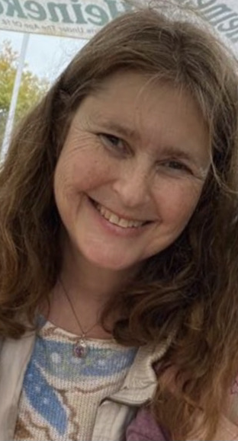
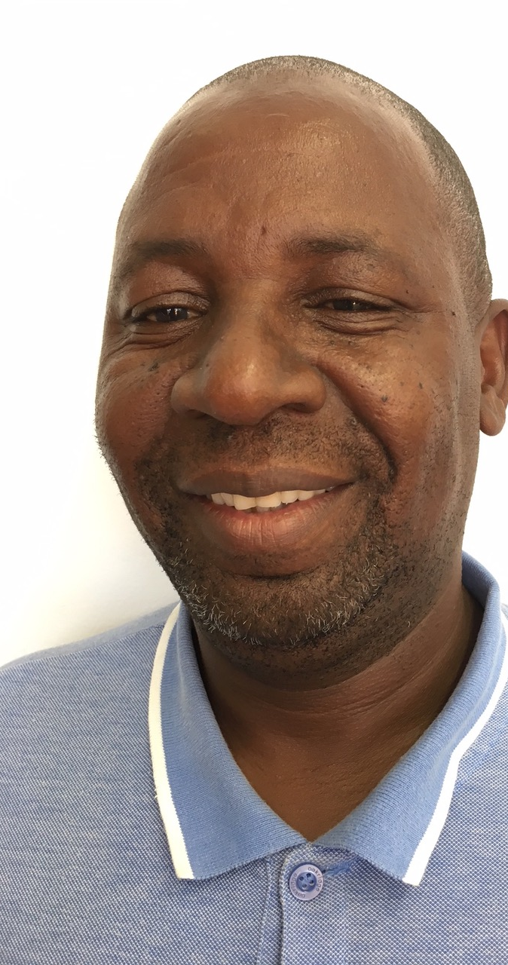
Meet our LEADERs
Andy Bolnick (CEO) is an experienced urbanist and development practitioner with 21 years expertise in managing projects in the built environment. She founded iKhayalami in 2006. She is an Ashoka and a Harvard Loeb Fellow, currently conducting research at MIT.
Ben Nkuna (Programme Manager) was General Manager at Small Enterprise Foundation and then the CEO at Women’s Development Business. In 2015 he became iKhayalami’s Operations Manager and in 2019 was appointed Programme Manager with a special focus on shelter upgrades.

Slide 11
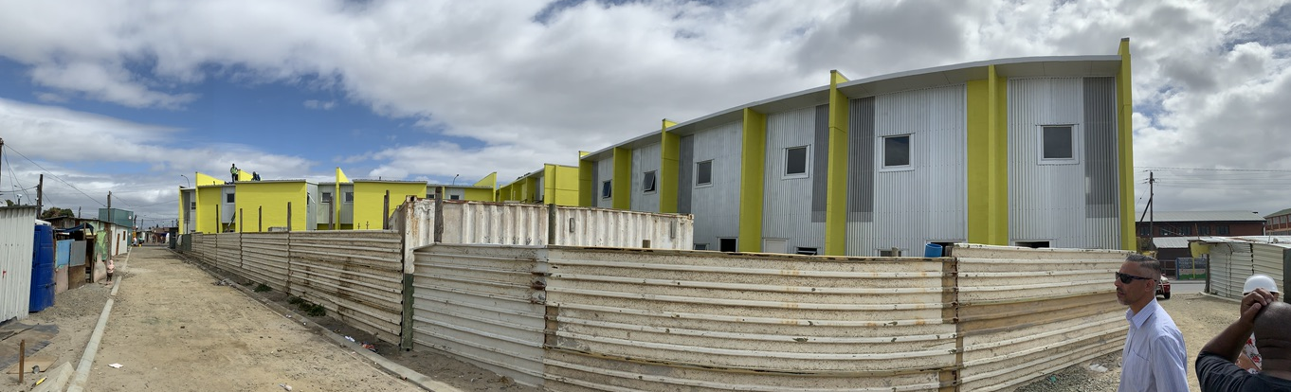
CONTACT DETAILS
Phone: 021 387 7958
E-Mail: andy@ikhayalami.org
ben@ikhayalami.org
Web: www.ikhayalami.org
Address: Unit 7, Teguka Park,
Hammer Rd, Philippi,
Cape Town 7441

